Slide 1
EHIME KELVIN EHINOMEN
22010303003
REGRESSION AND TIME SERIES MODELLING OF STUDENTS’ PERFORMANCE ACROSS SEMSTER
Project Supervisor
22nd January 2026
Mr Ekundayo

Slide 2

EHIME KELVIN EHINOMEN
220000
Content
Background to the Study
Related Works
Problem Statement
AC
Aim & Objectives
Financial Chart
Scope & Limitations
Project Roadmap
Methodology Overview
Marketing Strategy
Jan 2026
Variables
Our Team

Slide 3

Background to
the Study
Academic performance is a key indicator of students’ success and institutional effectiveness in
higher education. It reflects how well students understand course content and meet academic
requirements over time. In tertiary institutions, students’ academic performance is commonly
measured using the Grade Point Average (GPA) or Cumulative Grade Point Average (CGPA),
which often varies across semesters due to academic workload, study habits, attendance, and
prior academic achievement.

Slide 4
Background to
the Study
In recent years, there has been increasing interest in the application of mathematical and statistical techniques to analyze and predict students’ academic performance. Applied mathematics provides tools such as regression analysis, time-series modelling, and stochastic processes that can be used to describe performance trends, identify influential factors, and forecast future outcomes. These models are valuable for academic planning, early identification of at-risk students, and informed decision-making by educational administrators

Slide 5
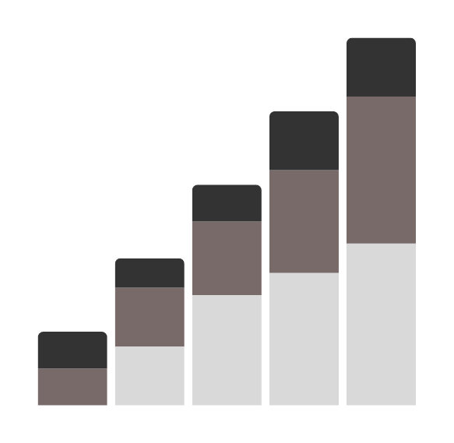

Problem
Statement
Students’ academic performance in higher education often varies from one semester to another due to difference in academic workload, study habits, attendance and prior academic achievements. However most institutions rely on raw data without systematically analysing these factors or predicting future performance. This lack of quantitative insight makes it hard to identify students who are not performing well and to take quick actions.

Slide 6

AIM
The principal goal of this research is to apply mathematical and statistical modelling techniques to academic performance data in order to identify trends, quantify influencing factors and predict students’ academic outcomes for improved decision-making.

Slide 7

Objectives
To collect and organize students’ academic performance data including GPA, attendance rate, study hours, and course load.
Analyse patterns in students’ academic performance and identify patterns of improvement or decline.
Develop an applied mathematical and statistical model that explains the relationship between academic performance and its influencing factors.

Slide 8
Scope
Limitations
Focuses on modelling and predicting students’ academic performance using GPA data
Some variables (such as study hours
and attendance) may be estimated or self-reported,which can introduce bias or measurement errors.
The study considers quantitave academic variables, including students’ Grade point Average (GPA), previous academic performance, attendance rate, study hours, and no of registered courses
The regression models assume linear relationships between variables, whereas real academic performance may involve nonlinear or complex interactions.
Limited generalizability, since the study is based on data from a specific department or institution.
Restricted set of variables, as only academic and study-related factors were considered.

Slide 9



METHODOLOGY
RESEARCH &
DISCOVERY
DATA
COLLECTION
DATA
ANALYSIS
Quantitative modeling using mathematics and statistics
Gather academic records,
Anonymize data
Handle missing values
Selected students from the
department for pilot study.
Trend Analysis: Examine GPA patterns over time.
Descriptive Statistics: Mean, min, max, standard deviation of GPA and other variables.

Slide 10
METHODOLOGY
REGRESSION
MODELLING
MODEL
DEPLOYMENT
DATA
ANALYSI
Quantitative modeling using mathematics and statistics
Gather academic records,
Anonymize data
Handle missing values
Selected students from the
department for pilot study.
Trend Analysis: Examine GPA patterns over time.
Descriptive Statistics: Mean, min, max, standard deviation of GPA and other variables.

Slide 11
VARIABLES
TYPE
DESCRIPTION
GPA
Dependent
Measure of academic performance
PREVIOUS GPA
Independent
Prior academic achievements
ATTENDANCE
Independent
Class participation level
COURSE LOAD
Independent
No of registerd courses
STUDY HOURS
Independent
Weekly study hours

Slide 12
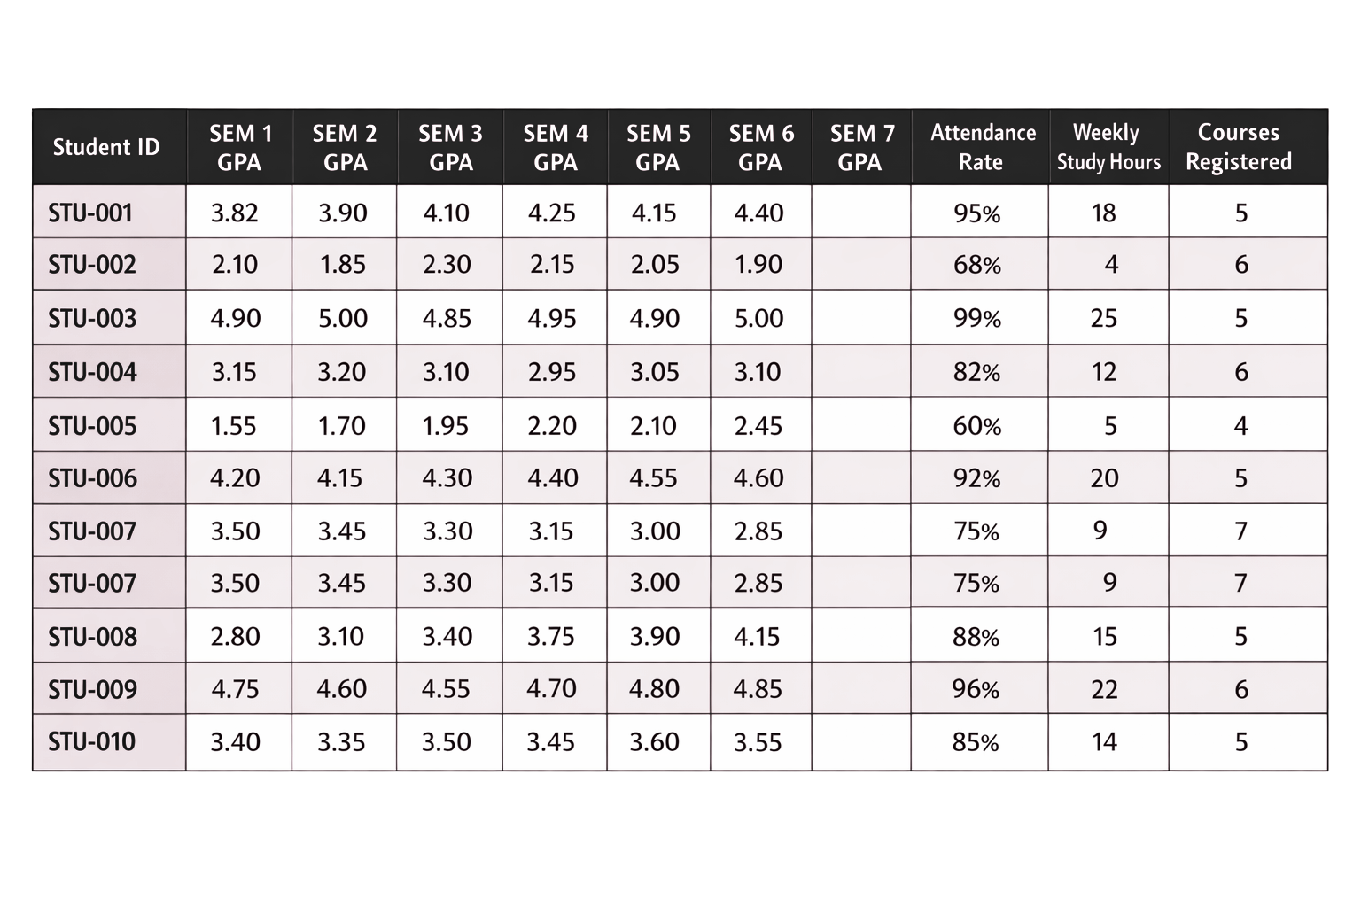
A PILOT STUDY SAMPLE OF 10 STUDENTS

Slide 13
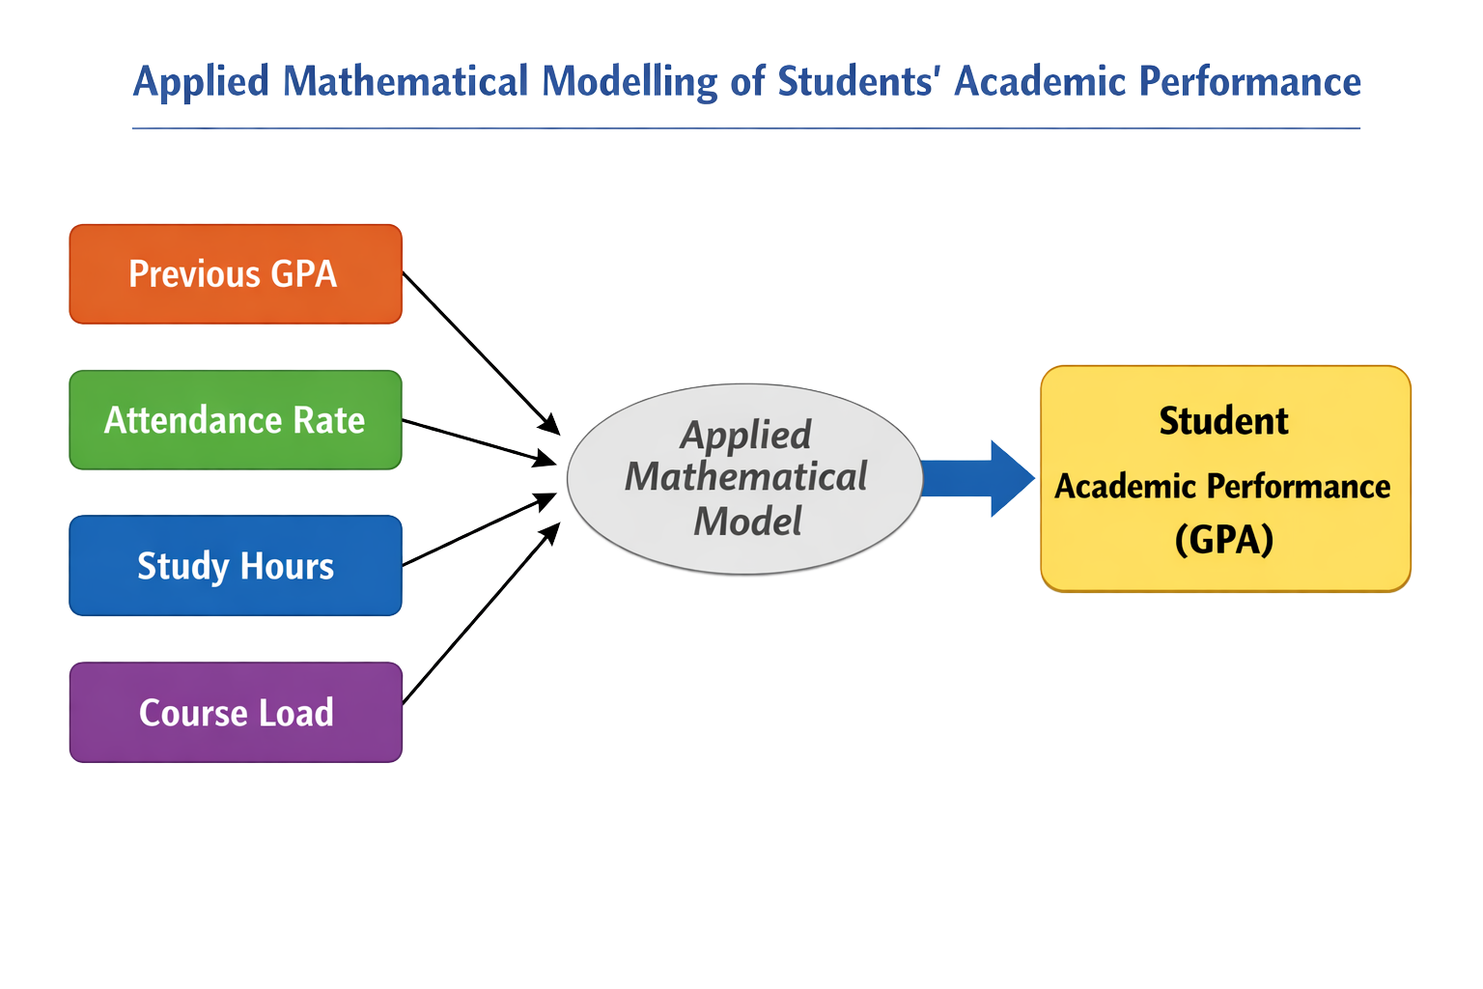

Slide 14
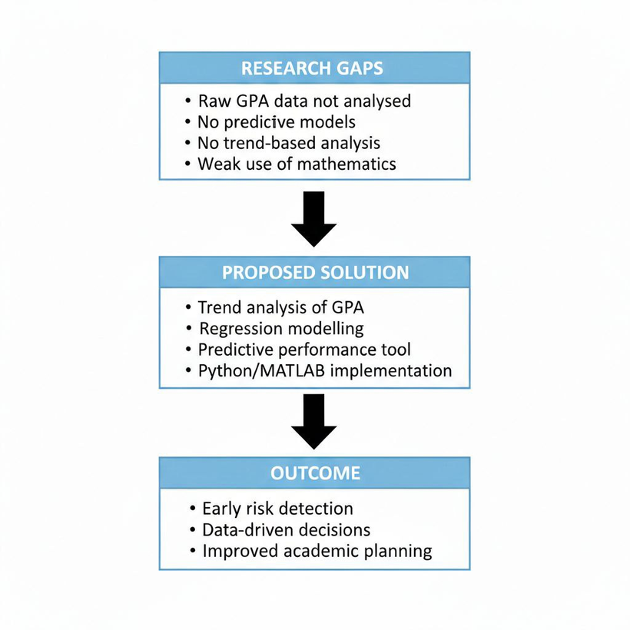
RESEARCH GAPS & SOLUTIONS
Most institutions rely on descriptive summaries of GPA without applying rigorous mathematical models
Lack of Predictive Tools for Early Identification of At-Risk Students
Inadequate Analysis of Performance Trends Over Time
Weak Integration of Theory and Practical Application. Some studies focus on theory without practical deployment.

Slide 15
Related Works
Neha & Kumar, 2023
Title: Enhancing Graduate Academic Performance Prediction and Classification: An Analysis Using the Enhanced Correlated Feature Set Model
Scope: Utilizes deep learning, Date mining an Classification techniqua to analyse academic trajectories
Akuma, S., & Abakpa, H, (2021)
Title: Predicting Undergraduate Level Students’ Performance Using Regression’
Scope: To develop a mathematical model using Linear Regression Algorithm to predict students’ final results. Measuing correlation coefficient and Mean Square Error(MSE)

Slide 16
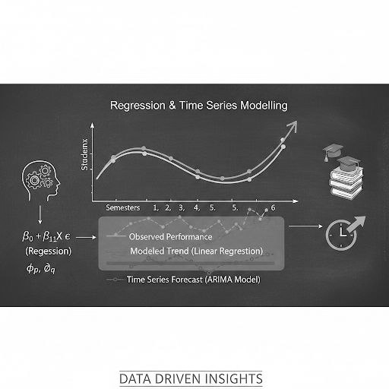
Thank you
For your attention

